Slide 1
Spark Streaming

Slide 2
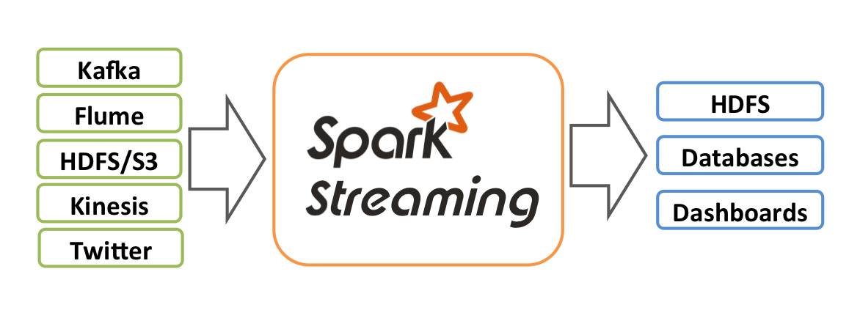
Spark Streaming
Spark Streaming is an extension of the core Spark API that enables scalable, high-throughput, fault-tolerant stream processing of live data streams.

Slide 3
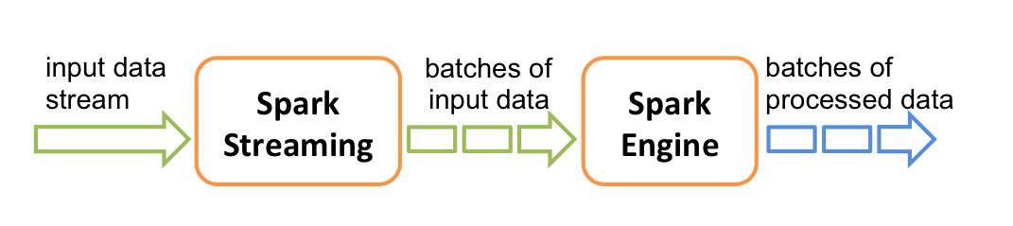
It’s actually “Mini Batch”
Spark Streaming receives live input data streams and divides the data into batches, which are then processed by the Spark engine to generate the final stream of results in batches.

Slide 4
It’s actually “Mini Batch”
Batches of Resilient Distributed Datasets (RDDs) are passed to Spark Streaming, which processes these batches using the Spark Engine and returns a processed stream of batches.
The processed stream can be written to a file system. The batch size can be as low as 0.5 seconds, leading to an end-to-end latency of less than 1 second.

Slide 5
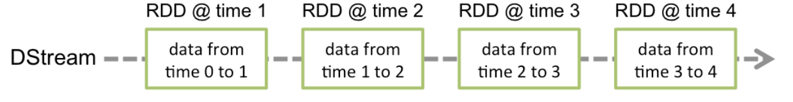
DStreams
The abstraction Spark Streaming uses is a called a discretized stream or DStream
These are just the batches of Resilient Distributed Datasets (RDDs)
Notes:
these are replicated in a clustter

Slide 6
Spark Streaming Sources
Spark Streaming provides two categories of built-in streaming sources.
Basic sources: Sources directly available in the StreamingContext API. Examples: file systems, and socket connections.
Advanced sources: Sources like Kafka, Flume, Kinesis, etc. are available through extra utility classes. These require linking against extra dependencies.

Slide 7
Spark Streaming Example: Word Count
Say we want to count the number of words in text data received from a data server listening on a TCP socket.
First, we need to create a StreamingContext, let’s make one with two execution threads, and batch interval of 2 second.
from pyspark import SparkContext from pyspark.streaming import StreamingContext # Create a local StreamingContext with two working thread and batch interval of 1 second sc = SparkContext("local[2]", "NetworkWordCount") ssc = StreamingContext(sc, 2)

Slide 8
Spark Streaming Example: Word Count
Next, create a DStream that represents streaming data from a TCP source, specified as hostname (e.g. localhost) and port.
# Create a DStream that will connect to hostname:port, like localhost:9999 lines = ssc.socketTextStream("localhost", 9999)
This lines DStream represents the stream of data that will be received from the data server. Each record in this DStream is a line of text. Next, we want to split the lines by space into words.
# Split each line into words words = lines.flatMap(lambda line: line.split(" "))

Slide 9
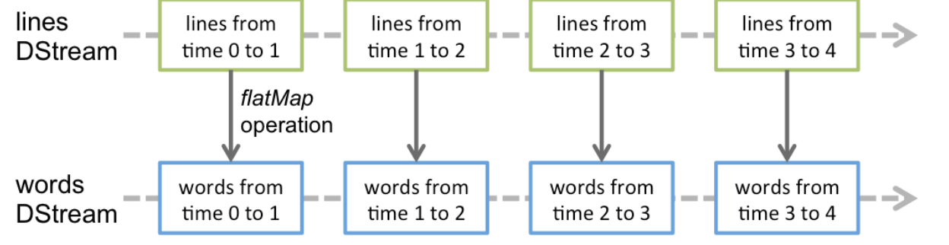
Spark Streaming Example: Word Count
# Split each line into words words = lines.flatMap(lambda line: line.split(" "))
flatMap is a one-to-many DStream operation that creates a new DStream by generating multiple new records from each record in the source DStream.
In this case, each line will be split into multiple words and the stream of words is represented as the words DStream.

Slide 10
Spark Streaming Example: Word Count
# Split each line into words words = lines.flatMap(lambda line: line.split(" "))
Next, count these words.
# Count each word in each batch pairs = words.map(lambda word: (word, 1)) wordCounts = pairs.reduceByKey(lambda x, y: x + y) # Print the first ten elements of each RDD generated in this DStream to the console wordCounts.pprint()

Slide 11
Spark Streaming Example: Word Count
When all the previous lines are executed, Spark Streaming only sets up the computation it will perform when it is started, and no real processing has started yet (like transformations).
To start the processing after all the transformations have been setup, we need to call:
ssc.start() # Start the computation ssc.awaitTermination() # Wait for the computation to terminate

Slide 12
Spark Streaming Example: Word Count
We’ll use a tool called Netcat to send streaming data via a network socket connection.
Netcat is networking utility for reading from and writing to network connections using TCP.
So, let’s open a shell in our docker image and send data to port 9999 using:
nc -l -p 9999

Slide 13
Spark Streaming Example: Word Count
Let’s open another shell in our docker image and now submit the spark job with the code in previous slides:
spark-submit spark-streaming-demo.py
Now, let’s type in data back in our shell with Netcat, and we can see the stream data being processed in the spark job shell!

Slide 14
File Stream Sources
streamingContext.textFileStream(dataDirectory)
Spark Streaming will monitor the directory dataDirectory and process any files created in that directory (files written in nested directories not supported).
The files must have the same data format.
Files must be created in the dataDirectory by atomically moving or renaming them into the data directory.
Once moved, the files must not be changed. So if the files are being continuously appended, the new data will not be read.

Slide 15
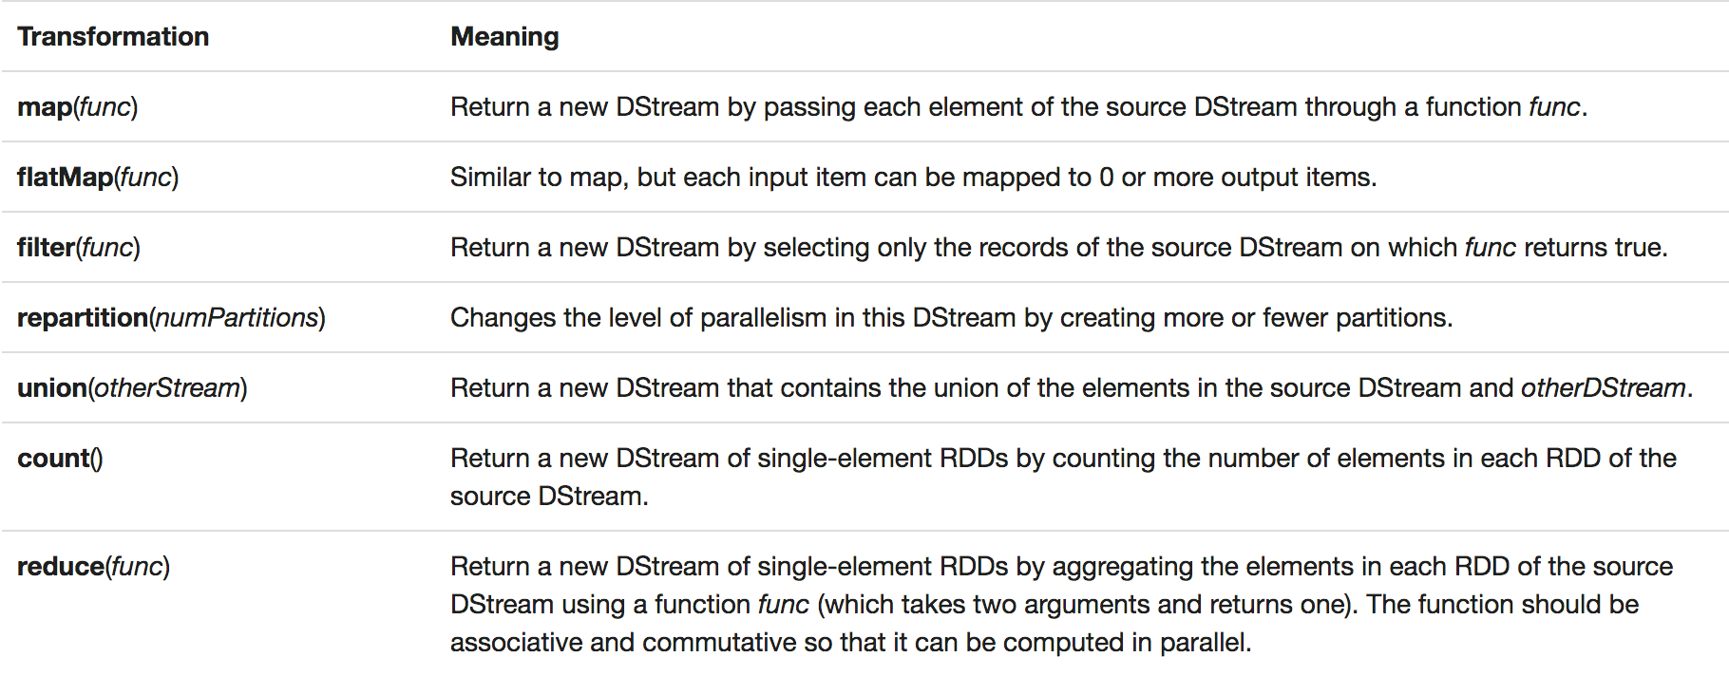
DStream transformations
DStreams support many of the transformations available on normal Spark RDD’s.

Slide 16
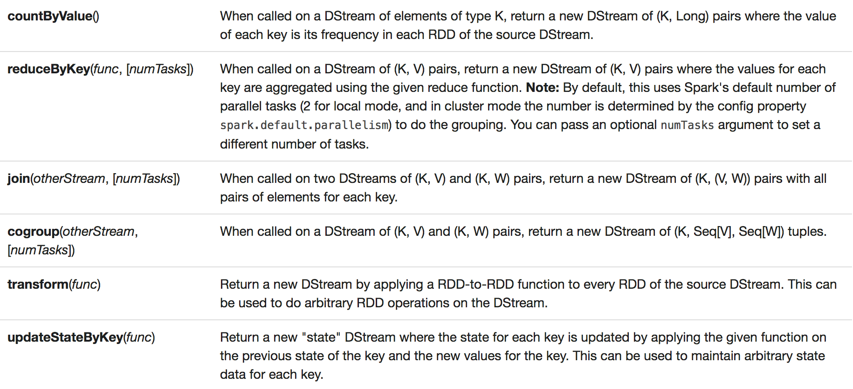
DStream transformations

Slide 17
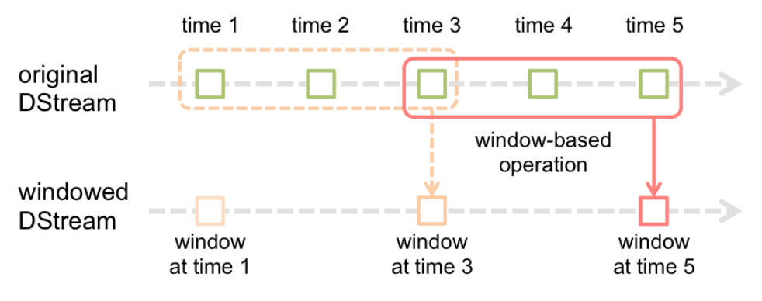
Windowed Computation
Spark Streaming also provides windowed computations, which allow you to apply transformations over a sliding window of data.

Slide 18
Windowed Computation
Every time the window slides over a source DStream, the source RDDs that fall within the window are combined and operated upon to produce the RDDs of the windowed DStream.
Notes:
In this specific case, the operation is applied over the last 3 time units of data, and slides by 2 time units.

Slide 19
Windowed Computation
Any window operation needs to specify two parameters.
window length - The duration of the window (3 in the figure).
sliding interval - The interval at which the window operation is performed (2 in the figure).
These two parameters must be multiples of the batch interval of the source DStream.

Slide 20
Windowed Computation
For example, let’s extend the earlier example by generating word counts over the last 30 seconds of data, every 10 seconds.
To do this, we can apply the reduceByKey operation on the pairs DStream of (word, 1) pairs over the last 30 seconds of data:
reduceByKeyAndWindow(func, windowLength, slideInterval)
# Reduce last 30 seconds of data, every 10 seconds windowedWordCounts = pairs.reduceByKeyAndWindow(lambda x, y: x + y, 30, 10)

